Slide 1


JavaScript
Sipan Sahakyan

Slide 2
What is JavaScript?
JavaScript was originally named Mocha, later it was renamed to LiveScript
JavaScript was initially created to “make web pages alive”.
JavaScript was developed by Netscape.
Why is it called JavaScript?
JavaScript is implementation of ECMAScript.
JavaScript is a scripting language.
JavaScript is used everywhere.
JavaScript is dynamically typed language.
Environments, V8 engine
Code Editors, IDE, Developer Console

Slide 3
Code Structure
Statements
Statements are syntax constructs and commands that perform actions.
alert('Hello');
Semicolons
We can have as many statements in our code as we want. Statements can be separated with a semicolon.
Comments
As time goes on, programs become more and more complex. It becomes necessary to add comments which describe what the code does and why.
One-line comments start with two forward slash characters //
// This comment occupies a line of its own
alert('Hello');
Multiline comments start with a forward slash and an asterisk /* and end with an asterisk and a forward slash */.

Slide 4
alert, prompt, confirm
alert(text);
It shows a message and waits for the user to press “OK”.
result = prompt(title, default?);
The function prompt accepts 2 arguments. It shows a modal window with a text message, an input field for the visitor, and the buttons OK/Cancel.
result = confirm(question);
Shows a message and waits for the user to press “OK” or “Cancel”. It returns true for OK and false for Cancel/Esc.

Slide 5
Variable
Computer programs use data
Data is like ingredients for our recipes; we use them to combine them with commands and get results
Data is a representation of some real world objects
For example, a person’s age may be stored as a number in the computer’s memory
Then a computer program can use that age (input) and display on the screen whether the person is of legal age (older than 18) (output)
This is an example of a simple program that uses some form of data

Slide 6
Declaring Variables
let
const
var let my_var; //declaration
my_var = 5; //assignment or let my_var = 5;
const BIRTHDAY = “1996.10.20”;
Variable naming
There are two limitations on variable names in JavaScript:
The name must contain only letters, digits, or the symbols $ and _.
The first character must not be a digit.

Slide 7
Primitive Types
numbers – for numbers of any kind: integer or floating-point, integers are limited by ±(2⁵³-1).
strings – for strings. A string may have zero or more characters, there’s no separate single- character type.
boolean – This type is commonly used to store yes/no values: true means “yes, correct”, and false means “no, incorrect”..
undefined – for unassigned values – a standalone type that has a single value undefined.
null – for unknown values – a standalone type that has a single value null.
Symbol (ES6) – for unique identifiers.
BigInt (ES11) - is for integer numbers of arbitrary length.

Slide 8
Basic operators
An operand – is what operators are applied to. For instance, in the multiplication of 5 * 2 there are two operands: the left operand is 5 and the right operand is 2. Sometimes, people call these “arguments” instead of “operands”.
An operator is unary if it has a single operand. For example, the unary negation - reverses the sign of a number:
let x = 1;
x = -x;
alert( x ); // -1, unary negation was applied
An operator is binary if it has two operands. The same minus exists in binary form as well:
let x = 1, y = 3;
alert( y - x ); // 2, binary minus subtracts values

Slide 9
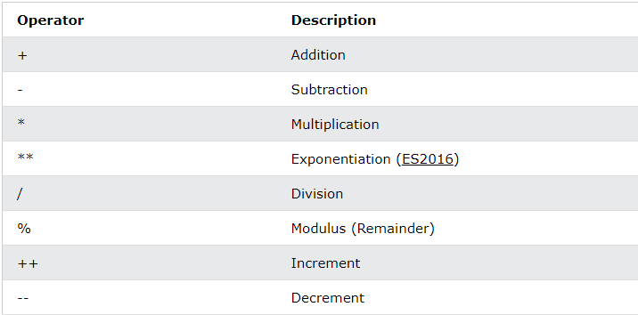
JavaScript Arithmetic Operators

Slide 10
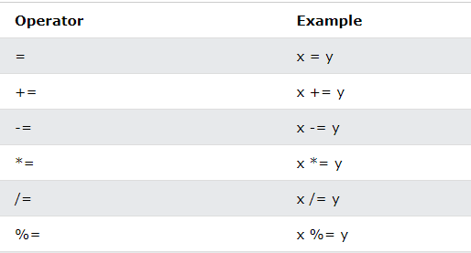
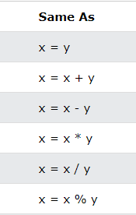
JavaScript Assingment Operators

Slide 11
Comparisons
In JavaScript they are written like this:
Greater/less than: a > b, a < b.
Greater/less than or equals: a >= b, a <= b.
Equals: a == b, please note the double equality sign == means the equality test, while a single one a = b means an assignment.
Not equals: In maths the notation is ≠, but in JavaScript it’s written as a != b.
All comparison operators return a boolean value:
true – means “yes”, “correct” or “the truth”.
false – means “no”, “wrong” or “not the truth”.

Slide 12
String comparison
The algorithm to compare two strings is simple:
Compare the first character of both strings.
If the first character from the first string is greater (or less) than the other string’s, then the first string is greater (or less) than the second. We’re done.
Otherwise, if both strings’ first characters are the same, compare the second characters the same way.
Repeat until the end of either string.
If both strings end at the same length, then they are equal. Otherwise, the longer string is greater.
alert( 'Z' > 'A' ); // true
alert( 'Glow' > 'Glee' ); // true
alert( 'Bee' > 'Be' ); // true

Slide 13
Comparison of different types
When comparing values of different types, JavaScript converts the values to numbers.
alert( '2' > 1 ); // true, string '2' becomes a number 2
alert( '01' == 1 ); // true, string '01' becomes a number 1
alert( true == 1 ); // true
alert( false == 0 ); // true

Slide 14
Strict equality
A regular equality check == has a problem. It cannot differentiate 0 from false:
alert( 0 == false ); // true
alert( '' == false ); // true
This happens because operands of different types are converted to numbers by the equality operator ==. An empty string, just like false, becomes a zero.
A strict equality operator === checks the equality without type conversion.
Comparison with null and undefined
alert( null === undefined ); // false
alert( null == undefined ); // true
For maths and other comparisons < > <= >= null/undefined are converted to numbers: null becomes 0, while undefined becomes NaN.

Slide 15
Summary
Comparison operators return a boolean value.
Strings are compared letter-by-letter in the “dictionary” order.
When values of different types are compared, they get converted to numbers (with the exclusion of a strict equality check).
The values null and undefined equal == each other and do not equal any other value.
Be careful when using comparisons like > or < with variables that can occasionally be null/undefined. Checking for null/undefined separately is a good idea.

Slide 16
Conditional branching: if
The if(...) statement evaluates a condition in parentheses and, if the result is true, executes a block of code.
let age = prompt('How old are you?')
If(age > 18 ){
// some code; }

Slide 17
Boolean conversion
The if (…) statement evaluates the expression in its parentheses and converts the result to a boolean.
A number 0, an empty string "", null, undefined, and NaN all become false. Because of that they are called “falsy” values.
Other values become true, so they are called “truthy”.

Slide 18
The “else” clause
The if (…) statement evaluates the expression in its parentheses and converts the result to a boolean.
A number 0, an empty string "", null, undefined, and NaN all become false. Because of that they are called “falsy” values.
Other values become true, so they are called “truthy”.
let year = prompt('In which year was the ECMAScript-2015 specification published?', '');
if (year == 2015) {
alert( 'You guessed it right!' );
} else {
alert( 'How can you be so wrong?' ); // any value except 2015
}

Slide 19
Several conditions: “else if”
let year = prompt('In which year was the ECMAScript-2015 specification published?', '');
if (year < 2015) {
alert( 'Too early...' );
} else if (year > 2015) {
alert( 'Too late' );
} else {
alert( 'Exactly!' );
}

Slide 20
Conditional(ternary) operator ‘?’
let result = condition ? value1 : value2;
Example:
let accessAllowed = (age > 18) ? true : false;
Multiple ‘?’
Example:
let age = prompt('age?', 18);
let message = (age < 3) ? 'Hi, baby!' :
(age < 18) ? 'Hello!' :
(age < 100) ? 'Greetings!' :
'What an unusual age!';
alert( message );

